Slide 1




Credit Card Fraud Detection
1
Capstone Project
By:
Rashmi Shetti,
Srijan Awasthi,
Mayur Jangale

Slide 2
Agenda
2
OBJECTIVE
BACKGROUND
KEY INSIGHTS
MODEL EVALUATION AND RECOMMEDATION
FINANCIAL IMPLICATION
APPENDIX :
Data attributes
Data Methodology
Models

Slide 3

Objective
3
Building a fraud detection system using different machine learning techniques for Finnex, a leading financial service provider in US.
To recommend optimal ways and preferable machine learning model Finnex can employ to mitigate fraud risks and prevent heavy financial losses.
Demonstrating the potential benefits of the final model through a cost-benefit analysis in order to analyze the business impact of fraudulent transactions.

Slide 4
Background
4
Finnex is a leading financial service provider based out of Florida, US. It offers a wide range of products and business services to customers through different channels, ranging from in-person banking and ATMs to online banking. Over the last few years, Finnex has observed that a significantly large number of unauthorized transactions are being made, due to which the bank has been facing a huge revenue and profitability crisis.
Numerous clients have been dissatisfied with the unlawful use of their credit or debit cards. It has been revealed that fraudsters access numerous cardholders' private and sensitive information through stolen or lost cards. Skimming, modifying real credit cards, and using fake cards are further examples of fraudulent transactions.
Because they are ignorant of continuous credit card theft or do not constantly monitor their bank account activities, clients frequently learn about such fraudulent purchases using their cards fairly late. Due to the delay in filing complaints with Finnex, the bank suffers significant losses and must compensate the cardholders for those losses by the time the case is marked as fraudulent.

Slide 5
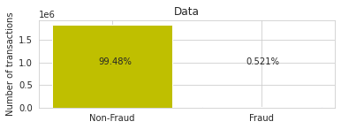
Data Imbalance
5
The dataset is highly imbalanced with positive class (frauds) accounting for 0.521% of the total transactions. This is a case of Minority class problem.
The ‘is_fraud’ column represents the target variable. It takes the value 1 in case of a fraudulent transaction and 0 otherwise.
The imbalance in the target variable is mitigated using Sampling techniques such as SMOTE and ADASYN.

Slide 6
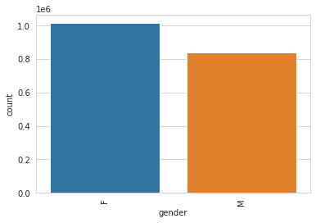
Gender Distribution
6
Compared to men, women make up a larger portion of the transaction frequencies. They may therefore be more vulnerable to fraud..
Percentage of female credit card holders is more as compared to male.
Women should receive education and training regarding the many methods used in credit card fraud.

Slide 7
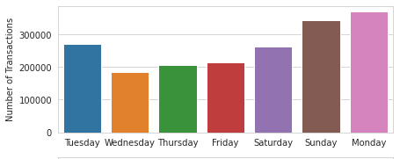
Fraud Distribution
7
More fraudulent transactions are happening on weekends than on weekdays.
A fraudulent transaction seem to have fewer anomalies as compared to non-fraudulent transaction as most of the users go shopping and travel on weekends only.

Slide 8
Model Building
8
The features which are assumed to be not holding any significance for the further Analysis have been removed.
The hyperparameter-tuned SMOTE Random forest model seems to be the best since it has the higher and most balanced Accuracy, F1 score, precision, and Recall.
Few different models have been implemented upon the processed dataset.

Slide 9
Financial Implications
9
After the model has been built we perform a cost-benefit analysis to demonstrate its potential benefits. For this we compared the cost incurred before and after the model is deployed.
After the model is deployed, the bank can develop a 2nd layer of authentication for each of the transaction that the model predicts as fraudulent. This would cost around $1.5 per fraudulent transaction.
The final cost incurred will only be due to left out fraudulent transactions that the model fails to detect and the installation cost of 2nd layer of authentication service .
Cost Benefit Analysis
S. No | Questions | Answer
a | Average number of transactions per month | 77183.08
b | Average number of fraudulent transaction per month | 402.12
c | Average amount per fraud transaction | 530.66

Slide 10
Financial Implications
10
Cost incurred per month before the model was deployed = Average amount per fraudulent transaction * Average number of fraudulent transactions per month
Cost incurred per month after the model is built and deployed = 1.5*TF + Average amount per fraudulent transaction * FN.
Final savings = Cost incurred before - Cost incurred after.
Cost Benefit Analysis
S. No | Questions | Answer
1 | Cost incurred per month before the model was deployed (b*c) | 213388.99
2 | Average number of transactions per month detected as fraudulent by the model (TF) | 684.33
3 | Cost of providing customer executive support per fraudulent transaction detected by the model | $1.5
4 | Total cost of providing customer support per month for fraudulent transactions detected by the model (TF*$1.5) | 1026.49
5 | Average number of transactions per month that are fraudulent but not detected by the model (FN) | 399.12
6 | Cost incurred due to fraudulent transactions left undetected by the model (FN*c) | 211797.01
7 | Cost incurred per month after the model is built and deployed (4+6) | 212823.5
8 | Final savings = Cost incurred before - Cost incurred after(1-7) | 565.49

Slide 11
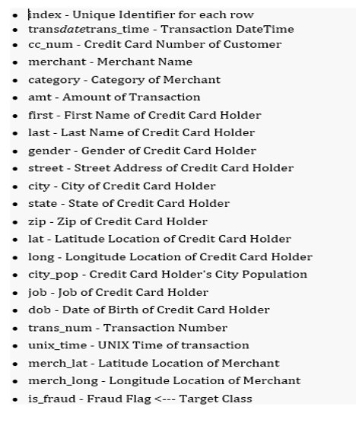
11
Appendix -
Data Attributes​
Snapshot of the dataset. ​​
Is_fraud is the target column.​
​

Slide 12
Appendix – Data Methodology
We conducted through Exploratory Analysis of the Credit Card dataset. There were no missing values in the dataset.
Transactions are the most on Monday. And transactions were the most on December of the both year, which also point that there could be a lot of frauds around that year but also as it is a very festive month
The 'trans_date_trans_time' feature has been broken down into several components like 'Age', 'day of the week', 'month' in order to contribute more briefly to our analysis.
12

Slide 13
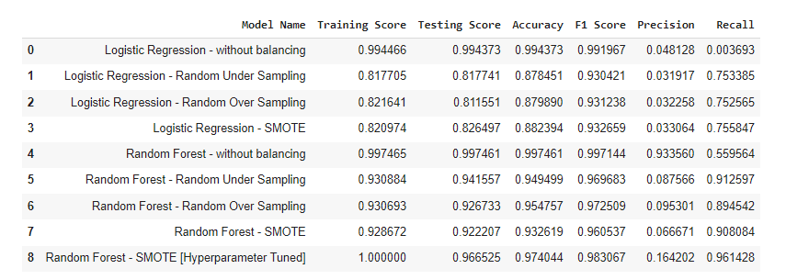
Appendix - Models
13
We performed the required different models.
A reasonable variety of different models were tested and evaluated on both imbalanced and balanced classes.
Stratified Train/test split was done so that each fold is a representative of all the strata of data.

Slide 14
Thank You

